Slide 1

Pruning the Protein Jungle
Recent developments in the CATH function prediction pipeline
Nicola Bordin
Notes:
Thank you for the opportunity,
Our approach to prune the protein jungle and

Slide 2


Pruning the protein jungle
180m
1.3bn
UniProt
Bacteria
Eukaryotes
Notes:
One of the biggest, UniProt 180m sequences. Massive expansion in sequencing data coming in from different sources. There are especially two ongoing projects that produce vast amount of protein data. MGnify for bacterial metagenomes, TOL which is aiming for the sequencing and characterisation for all 60.000 eukaryotes in the British Islands archipelago. Amounts already to 4bn, Hard to organise and characterise properly.

Slide 3
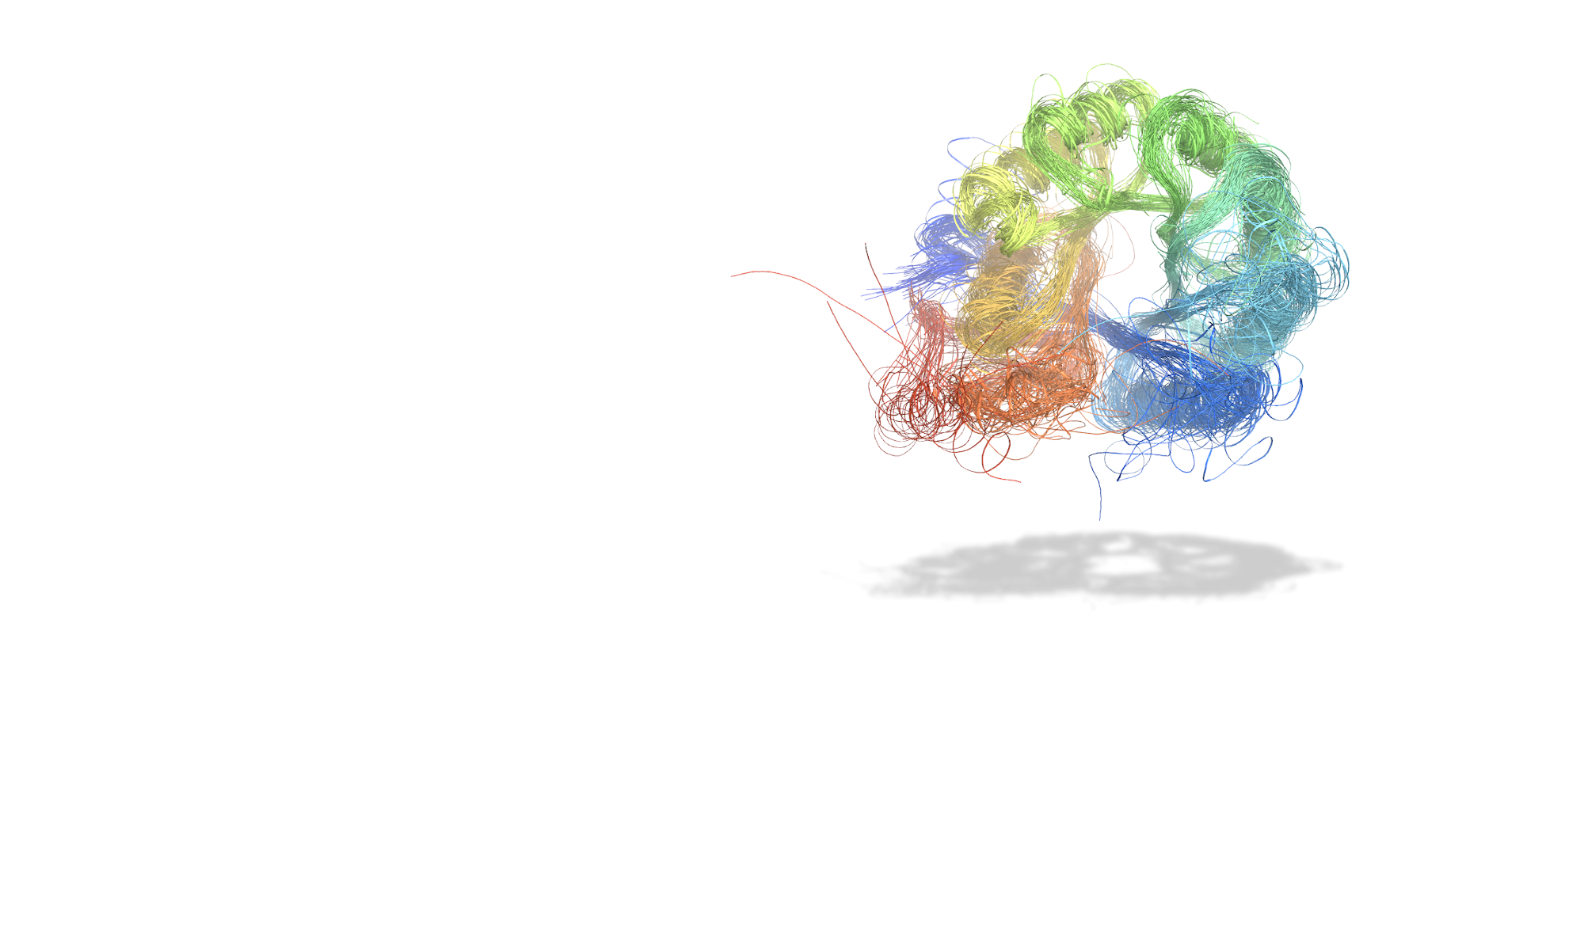
Pruning the protein jungle
C
A
T
H
Evolutionary families of protein domains
Notes:
To prune this protein jungle CATH, our data resource, classifies evolutionary families of protein domains

Slide 4
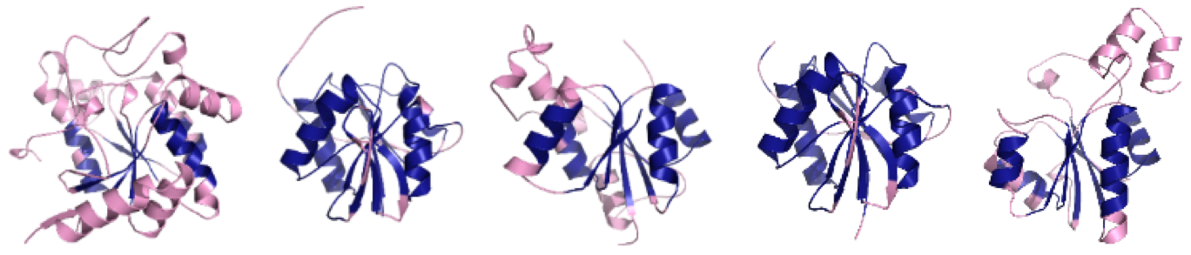
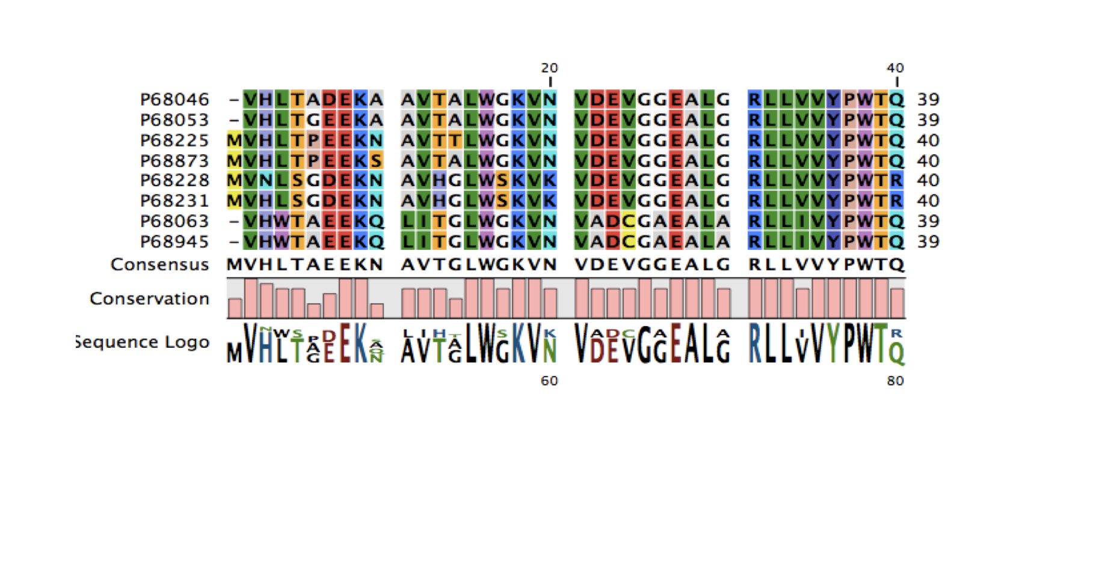
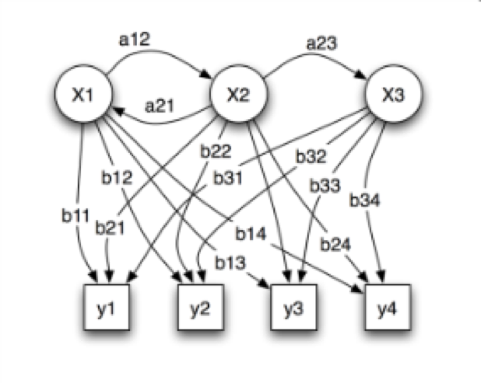
Expanding structure superfamilies with sequence data
Structures
Sequence profile
Hidden Markov Model (HMM)
Notes:
Initially using structural data, easy because it’s conserved. Pull sequences in the structural family. Encode sequence profile in HMM.

Slide 5
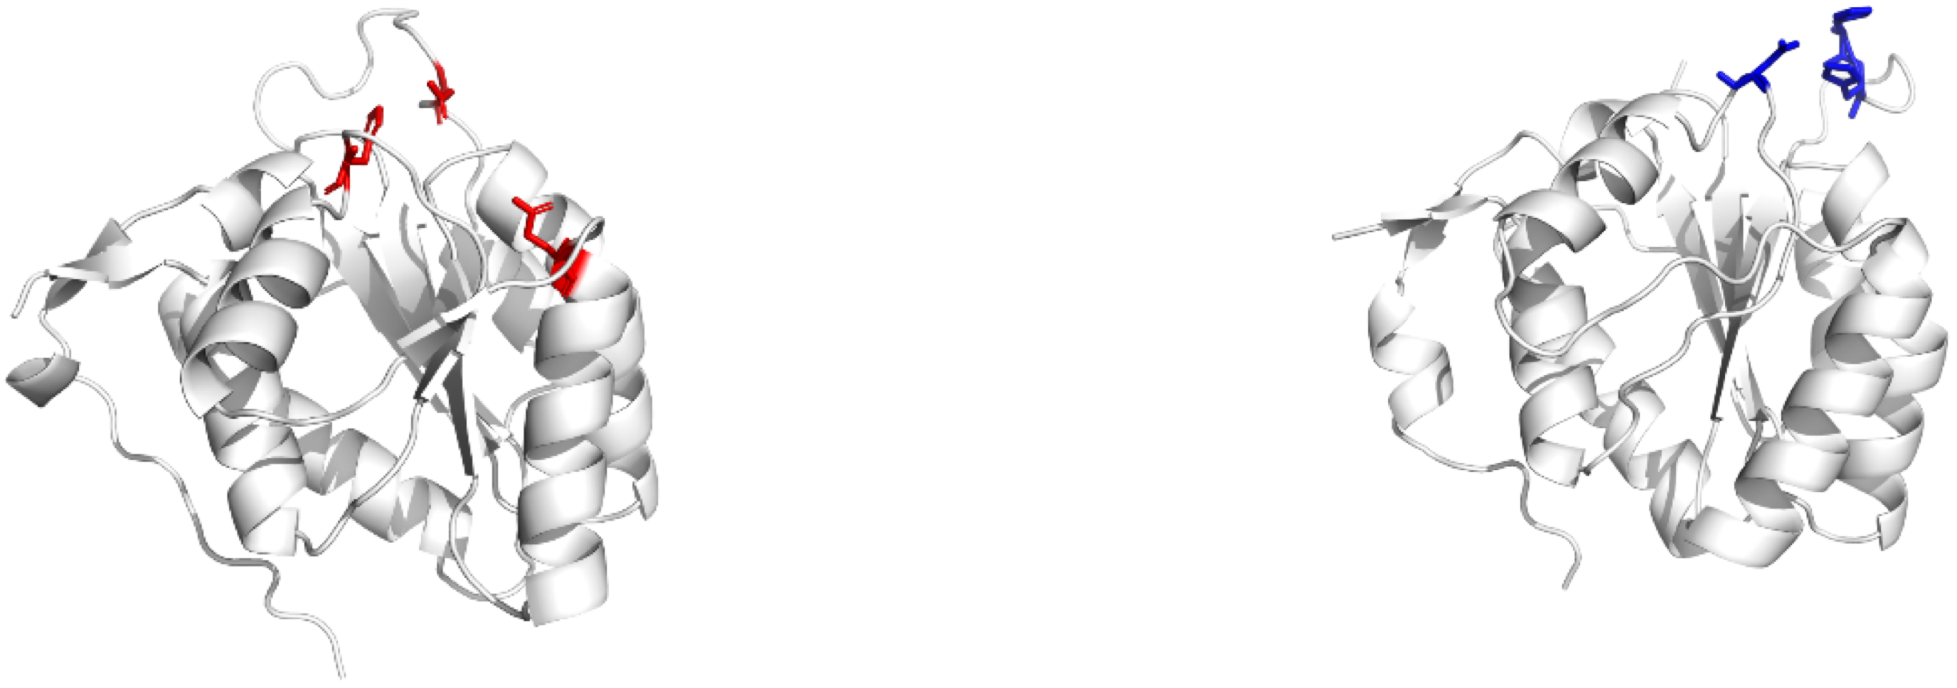
Functional Families (FunFams)
SuperFamily
Notes:
Enough structural divergence in paralogs -> results in different Functional Families

Slide 6
Functional Families (FunFams)
Benzaldehyde lyase
Pyruvate decarboxylase
Notes:
Enough structural divergence in paralogs -> different Functional Families
FunFams are functionally coherent subsets of sequences within a SuperFamily.

Slide 7
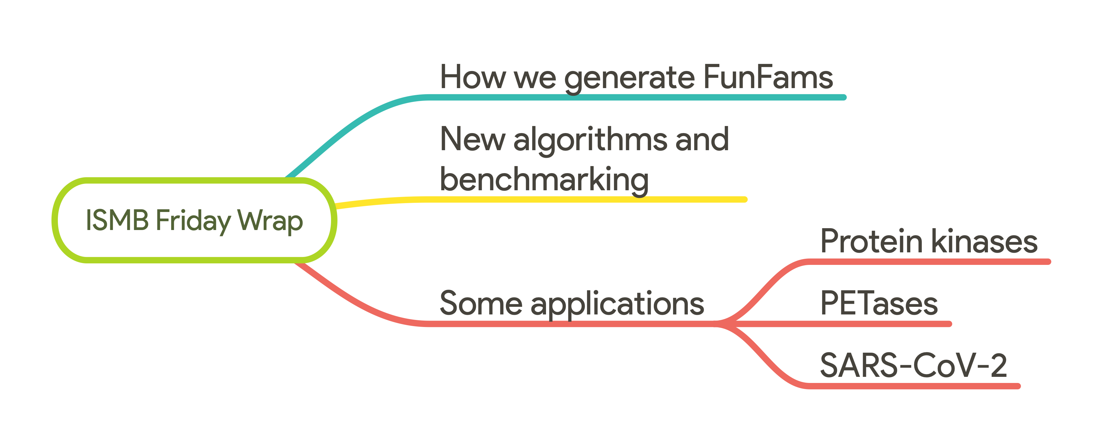
Talk overview
Notes:
For the next 20 minutes I’ll explain how

Slide 8
How we generate Functional Families from sequence data
s90 aln
s90 aln
merge aln
s90 aln
Collect Gene Ontology terms
Cluster sequences at 90% sequence similarity
Extract clusters with at least 1 experimental GO
Encode sequence pattern in a Hidden Markov Model
Create tree of relationships between HMM
s90 aln
s90 aln
s90 aln
s90 aln
s90 aln
s90 aln
s90 aln
s90 aln
s90 aln
Starting clusters
s90 aln
s90 aln
merge aln
Superfamily Sequences
s90 aln
s90 aln
Notes:
Describe GO

Slide 9
How we generate Functional Families from sequence data
Cut the tree to obtain functionally pure alignments

Slide 10
Conserved Positions
(ScoreCons)
FunFHMMER
Important for folding
A
C
P
R
L
D
V
D
S
A
Q
A
C
P
R
-
E
V
D
C
A
V
FunFam 1
G
C
P
R
I
E
V
D
S
A
R
G
C
G
R
I
E
V
D
S
A
D
A
C
G
K
L
E
I
D
A
I
P
A
C
A
K
L
E
-
D
A
I
P
FunFam 2
G
C
R
K
K
E
L
D
A
I
P
Specificity Determining Positions
Important for Function
Notes:
Caveat with this approach. It doesn’t work on massive trees with thousands of starting clusters and millions of sequences.

Slide 11
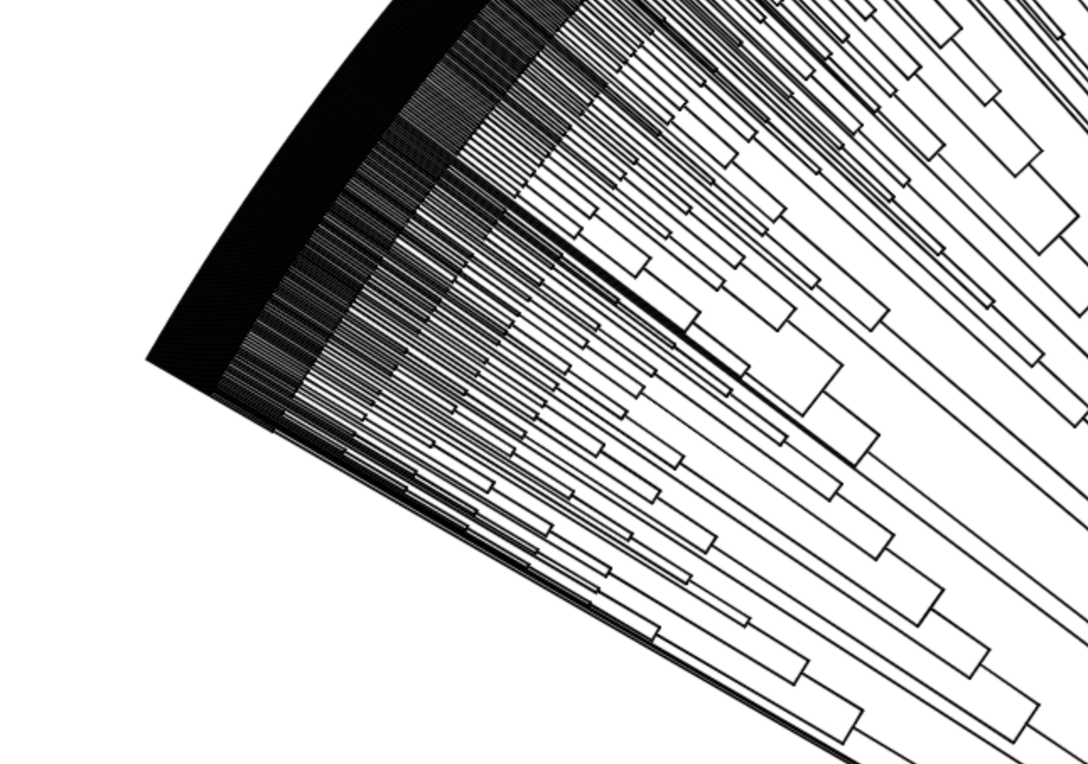
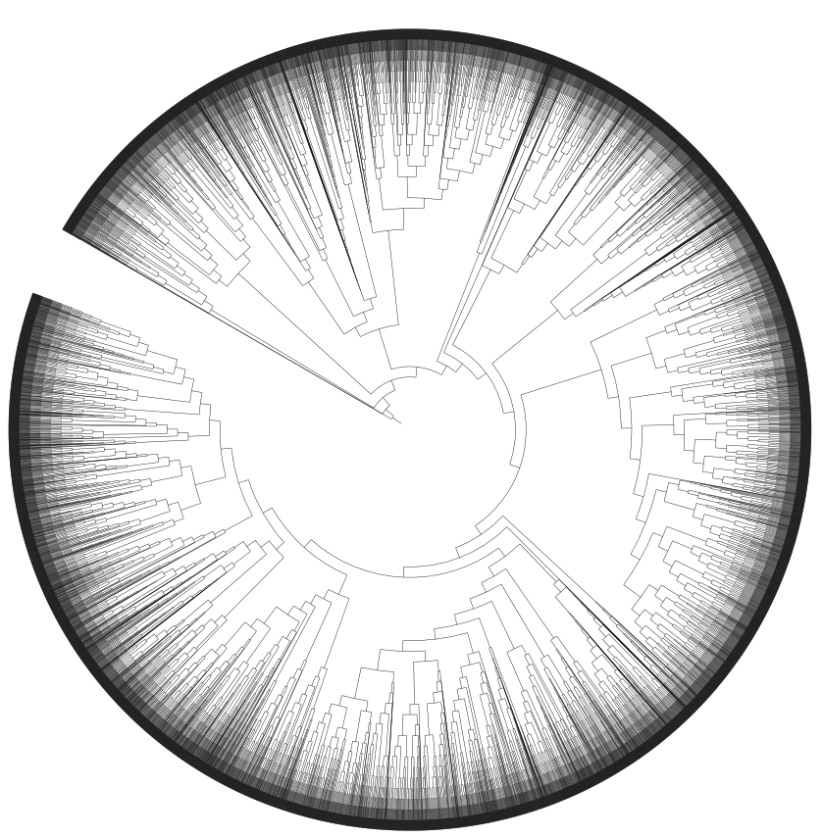
12 Massive SuperFamilies, too large to handle
~6 months on the UCL HPC
Notes:
12 Massive Superfamilies contain around 60% of all sequences in CATH. Previous FunFams generation -> 6 months time. Now they can contain millions of sequences, current method doesn’t work.

Slide 12
B
MDA-1
B
A
B
C
MDA-2
A
B
MDA-3
SuperFamily B
6 months
B
A
B
MDA-4
B
A
A
A
B
B1
MDA-5
B
B
MDA-6
Multi-Domain Architecture partitioning (MDA)
Notes:
Split according to the domain context
Context frequently changes function!
1/6 of the time, parallelisation. From 6 months to 6 weeks

Slide 13
DOMAIN B
B
MDA-1
B
A
B
C
MDA-2
A
B
MDA-3
SuperFamily B
6 weeks
B
A
B
MDA-4
B
A
A
A
B
B1
MDA-5
B
B
MDA-6
Multi-Domain Architecture partitioning (MDA)
Notes:
Split according to the domain context
Context frequently changes function!
1/6 of the time, parallelisation. From 6 months to 6 weeks

Slide 14
N-fold speed-up
MDA-1
MDA-2
FunFams
Starting Clusters for SuperFamily
Intermediary Starting Clusters
MDA-3

Slide 15
Number of SuperFamilies with Functional classification
FunFams
No FunFams
2620
OLD
3499
67,598 FunFams
3-fold increase in sequences

Slide 16
Number of SuperFamilies with Functional classification
FunFams
No FunFams
FunFams
No FunFams
2620
OLD
3499
4328
NEW
2303
67,598 FunFams
212,872 FunFams
3-fold increase in FunFams
Notes:
No funfams bc of lack of exp GO terms.

Slide 17
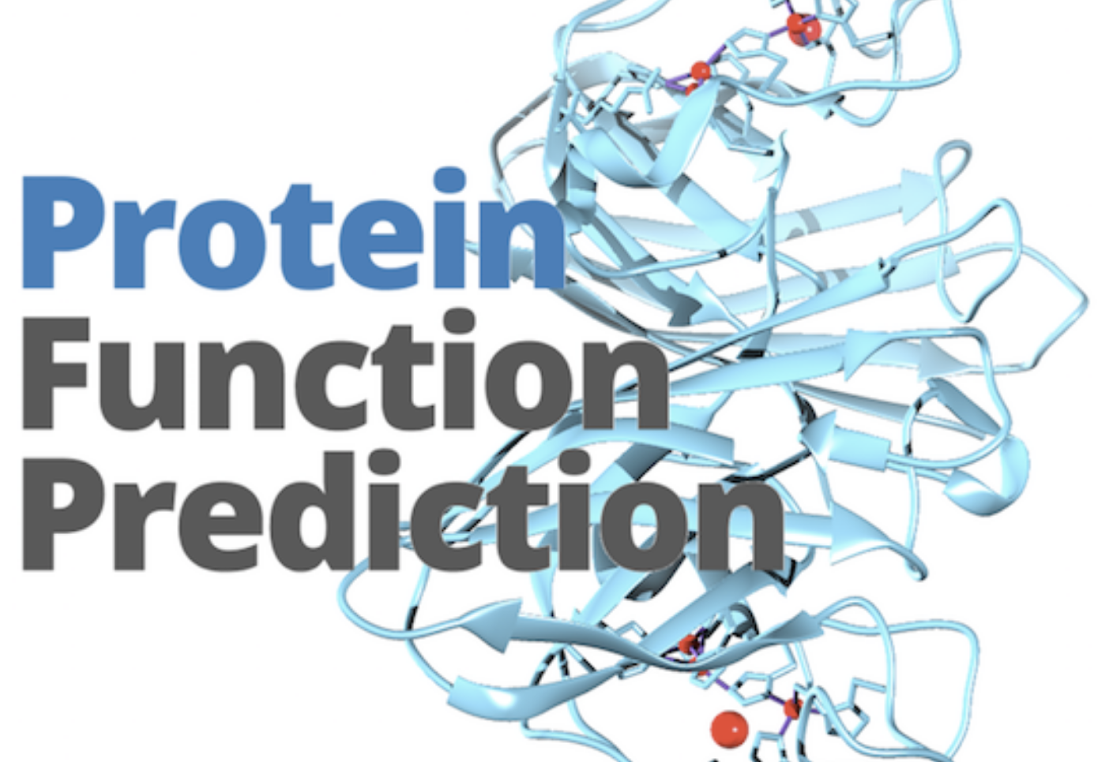
CAFA
Benchmark for protein function prediction
Assessed using experimentally characterised Gene Ontology terms
100,000 sequences to characterise
CATH-FunFams v4.2 ranked (out of 150) in CAFA3
2nd for Molecular Function
4th for Biological Process
9th for Cellular Component
Notes:
Introduce CAFA better.
We scan against our FunFams HMM.
The FunFams have at least 1 exp GO term that can be propagated.

Slide 18
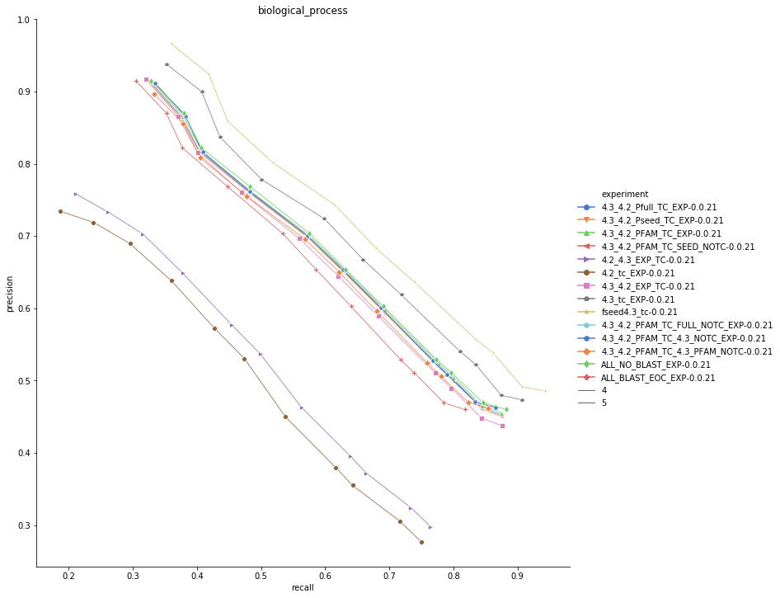
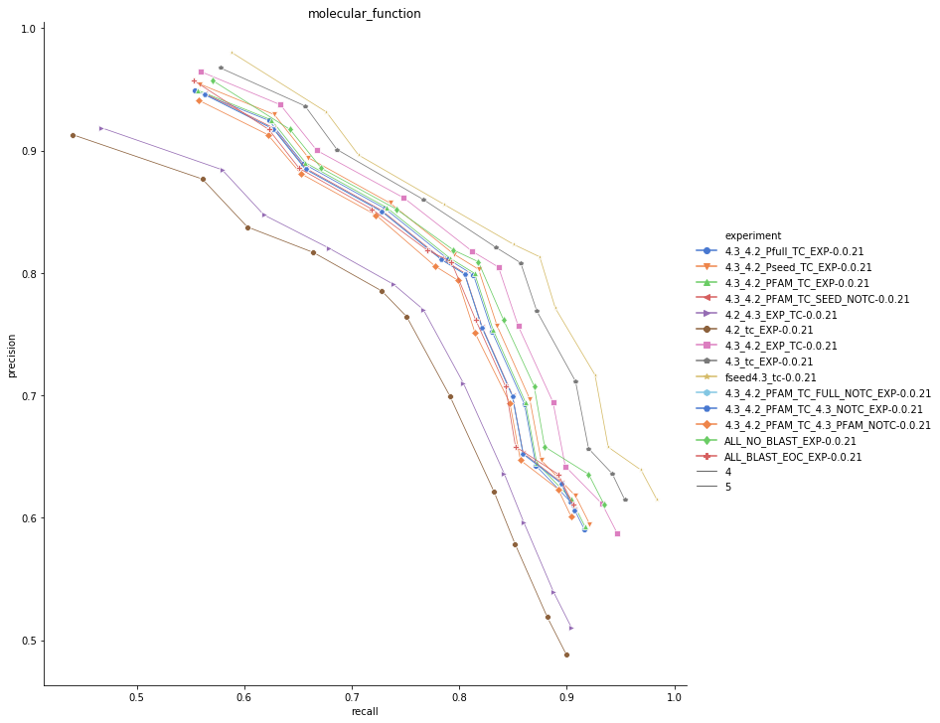
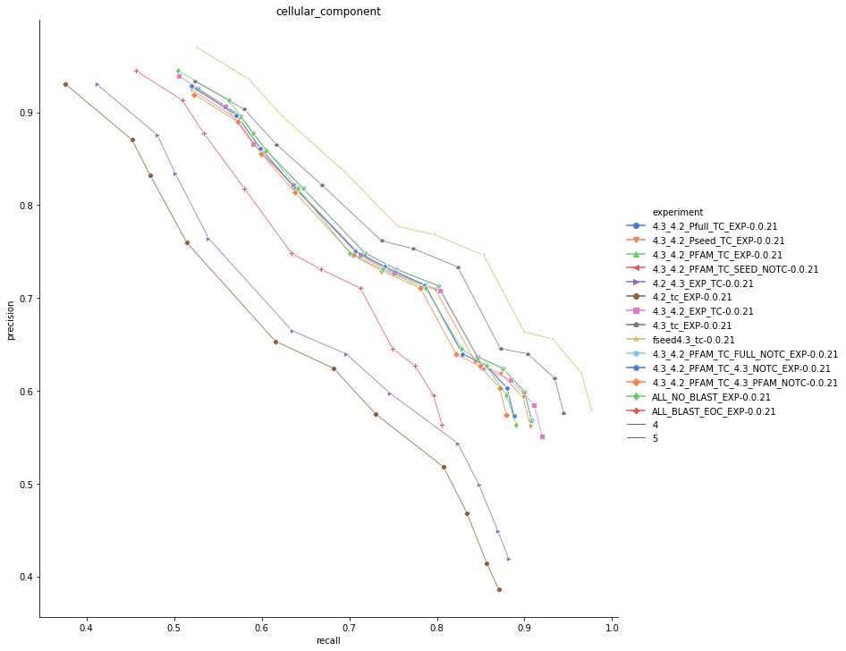
Benchmarks CAFA
NEW
NEW
Precision
NEW
Precision
Precision
OLD
OLD
OLD
Recall
Recall
Recall
Biological Process
Molecular Function
Cellular Component

Slide 19
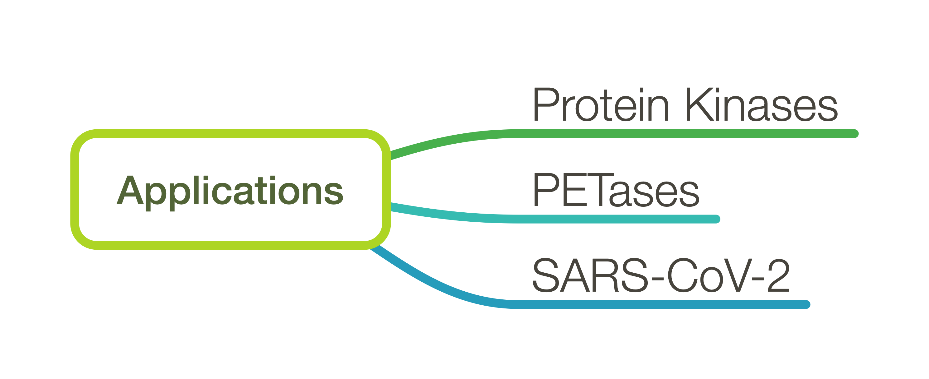
Notes:
For the remaining portion of my talk I’ll describe some applications.

Slide 20
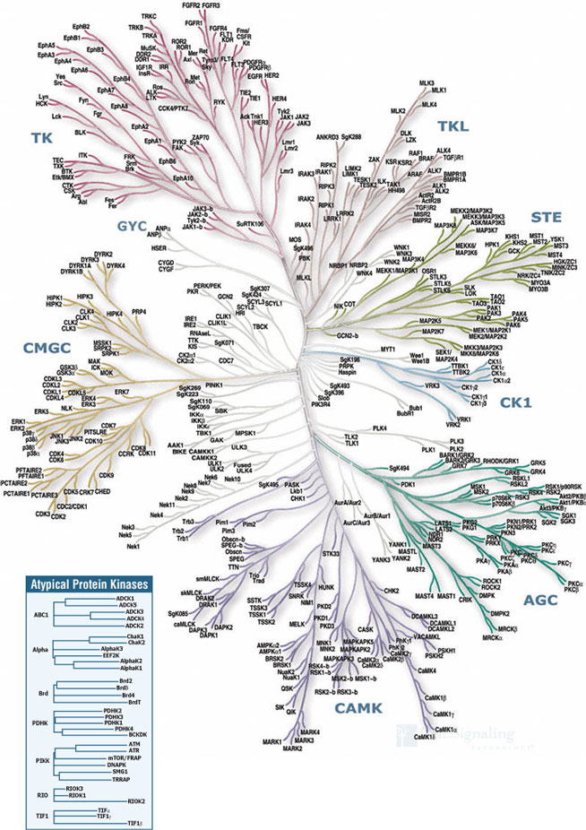
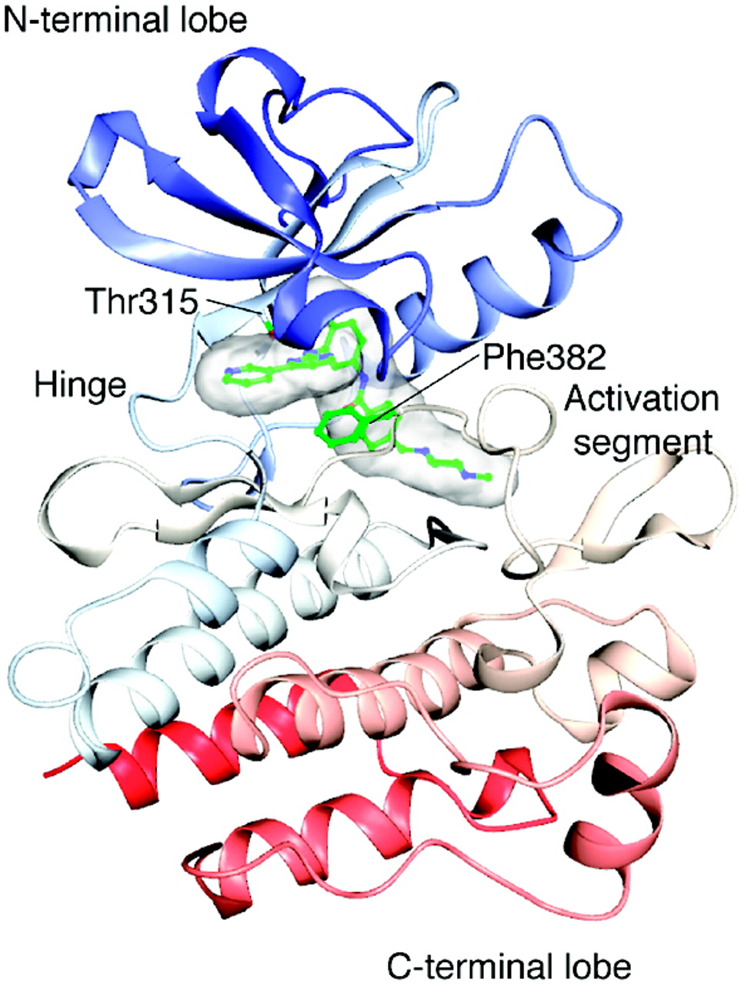
Updating the kinome
Martin E. M. Noble, Jane A. Endicott, Louise N. Johnson, Science, 2004
Credit: Cell Signalling Technologies
Notes:
Important set of proteins, drug targets.
Consists of 2 lobes connected by a hing region

Slide 21
Manning Kinase Classification
KinBase
Current Golden Standard
Not updated since 2012!
Mostly model organisms
Manually curated
Hundreds of thousands of sequences not classified in KinBase
9 Groups
134 Families
196 subfamilies
31.198 sequences

Slide 22
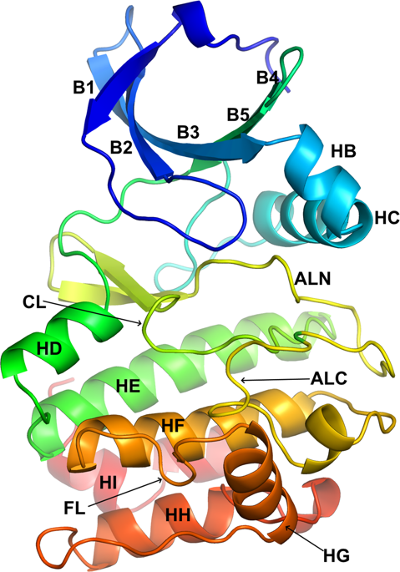
Encoding a protein kinase using CATH domains
N - lobe
C - lobe
N -
- C
Hinge region (20aa)
3.30.200.20
1.10.510.10
3.30.200.20
1.10.510.10
N -
- C
231,875 sequences
Hinge region (20aa)

Slide 23
17x expansion in sequences classified
 | Number of Families | Number of Sequences
KinFams | 2210 | 124,830
KinBase | 579 | 7379

Slide 24
Enzyme Classification
3.
1.
21.
4
General type of reaction
Enzyme sub-class
EC3
EC4
Enzyme sub-sub class
Substrate specificity

Slide 25
1EC
2 EC
1EC
2 EC
Comparable accuracy for chemistry

Slide 26
Notes:
Higher purity, automated vs manual! Structural coherence and drug repurposing, investigate novel kinases.

Slide 27

PET hydrolases
Notes:
Another challenging case, massive superfamily, the alpha-beta hydrolases.

Slide 28
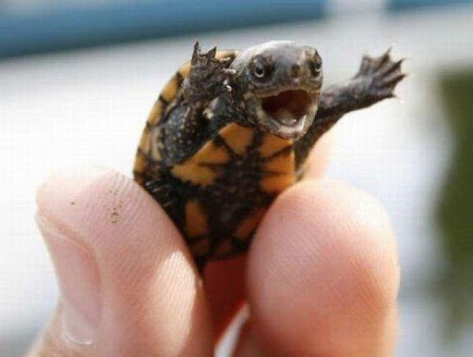
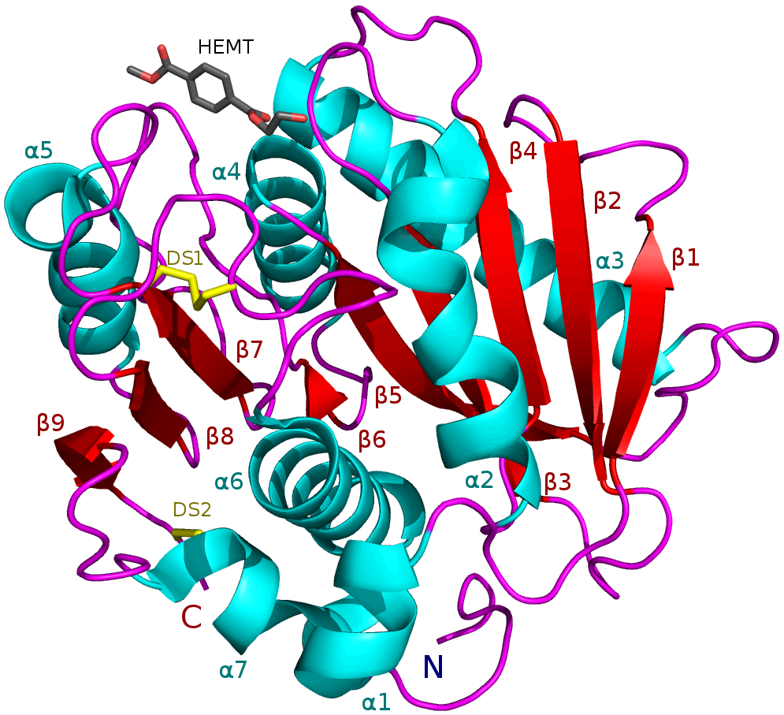
PET hydrolases
Han, Xu; Liu, Weidong et al. (2017-12-13). "Structural insight into catalytic mechanism of PET hydrolase". Nature Communications. 8
Goal: Identify novel, more efficient PET hydrolases
Can we find better PETases (i.e. new FunFams) in the metagenomes?

Slide 29
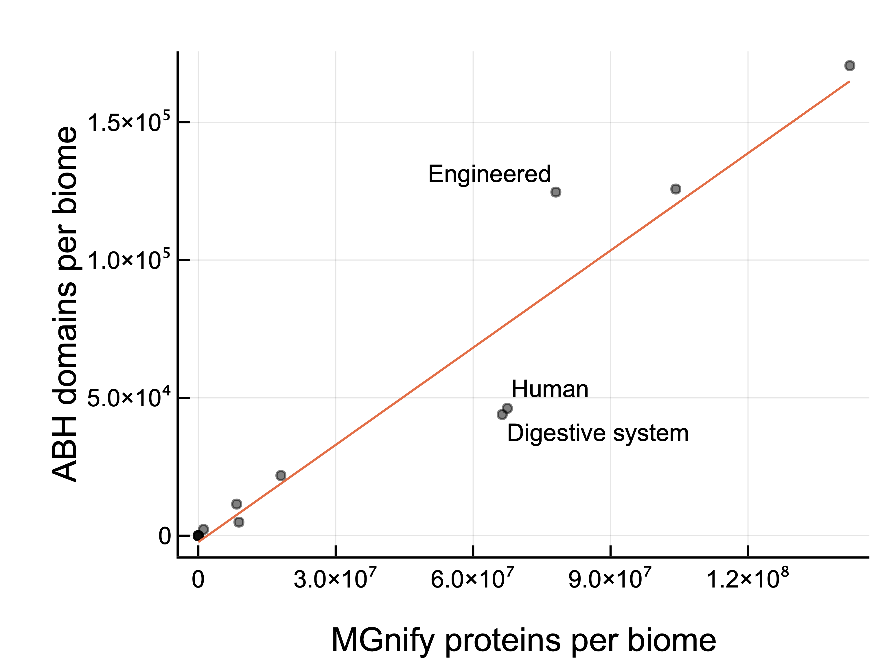
Alpha/Beta Hydrolases

Slide 30
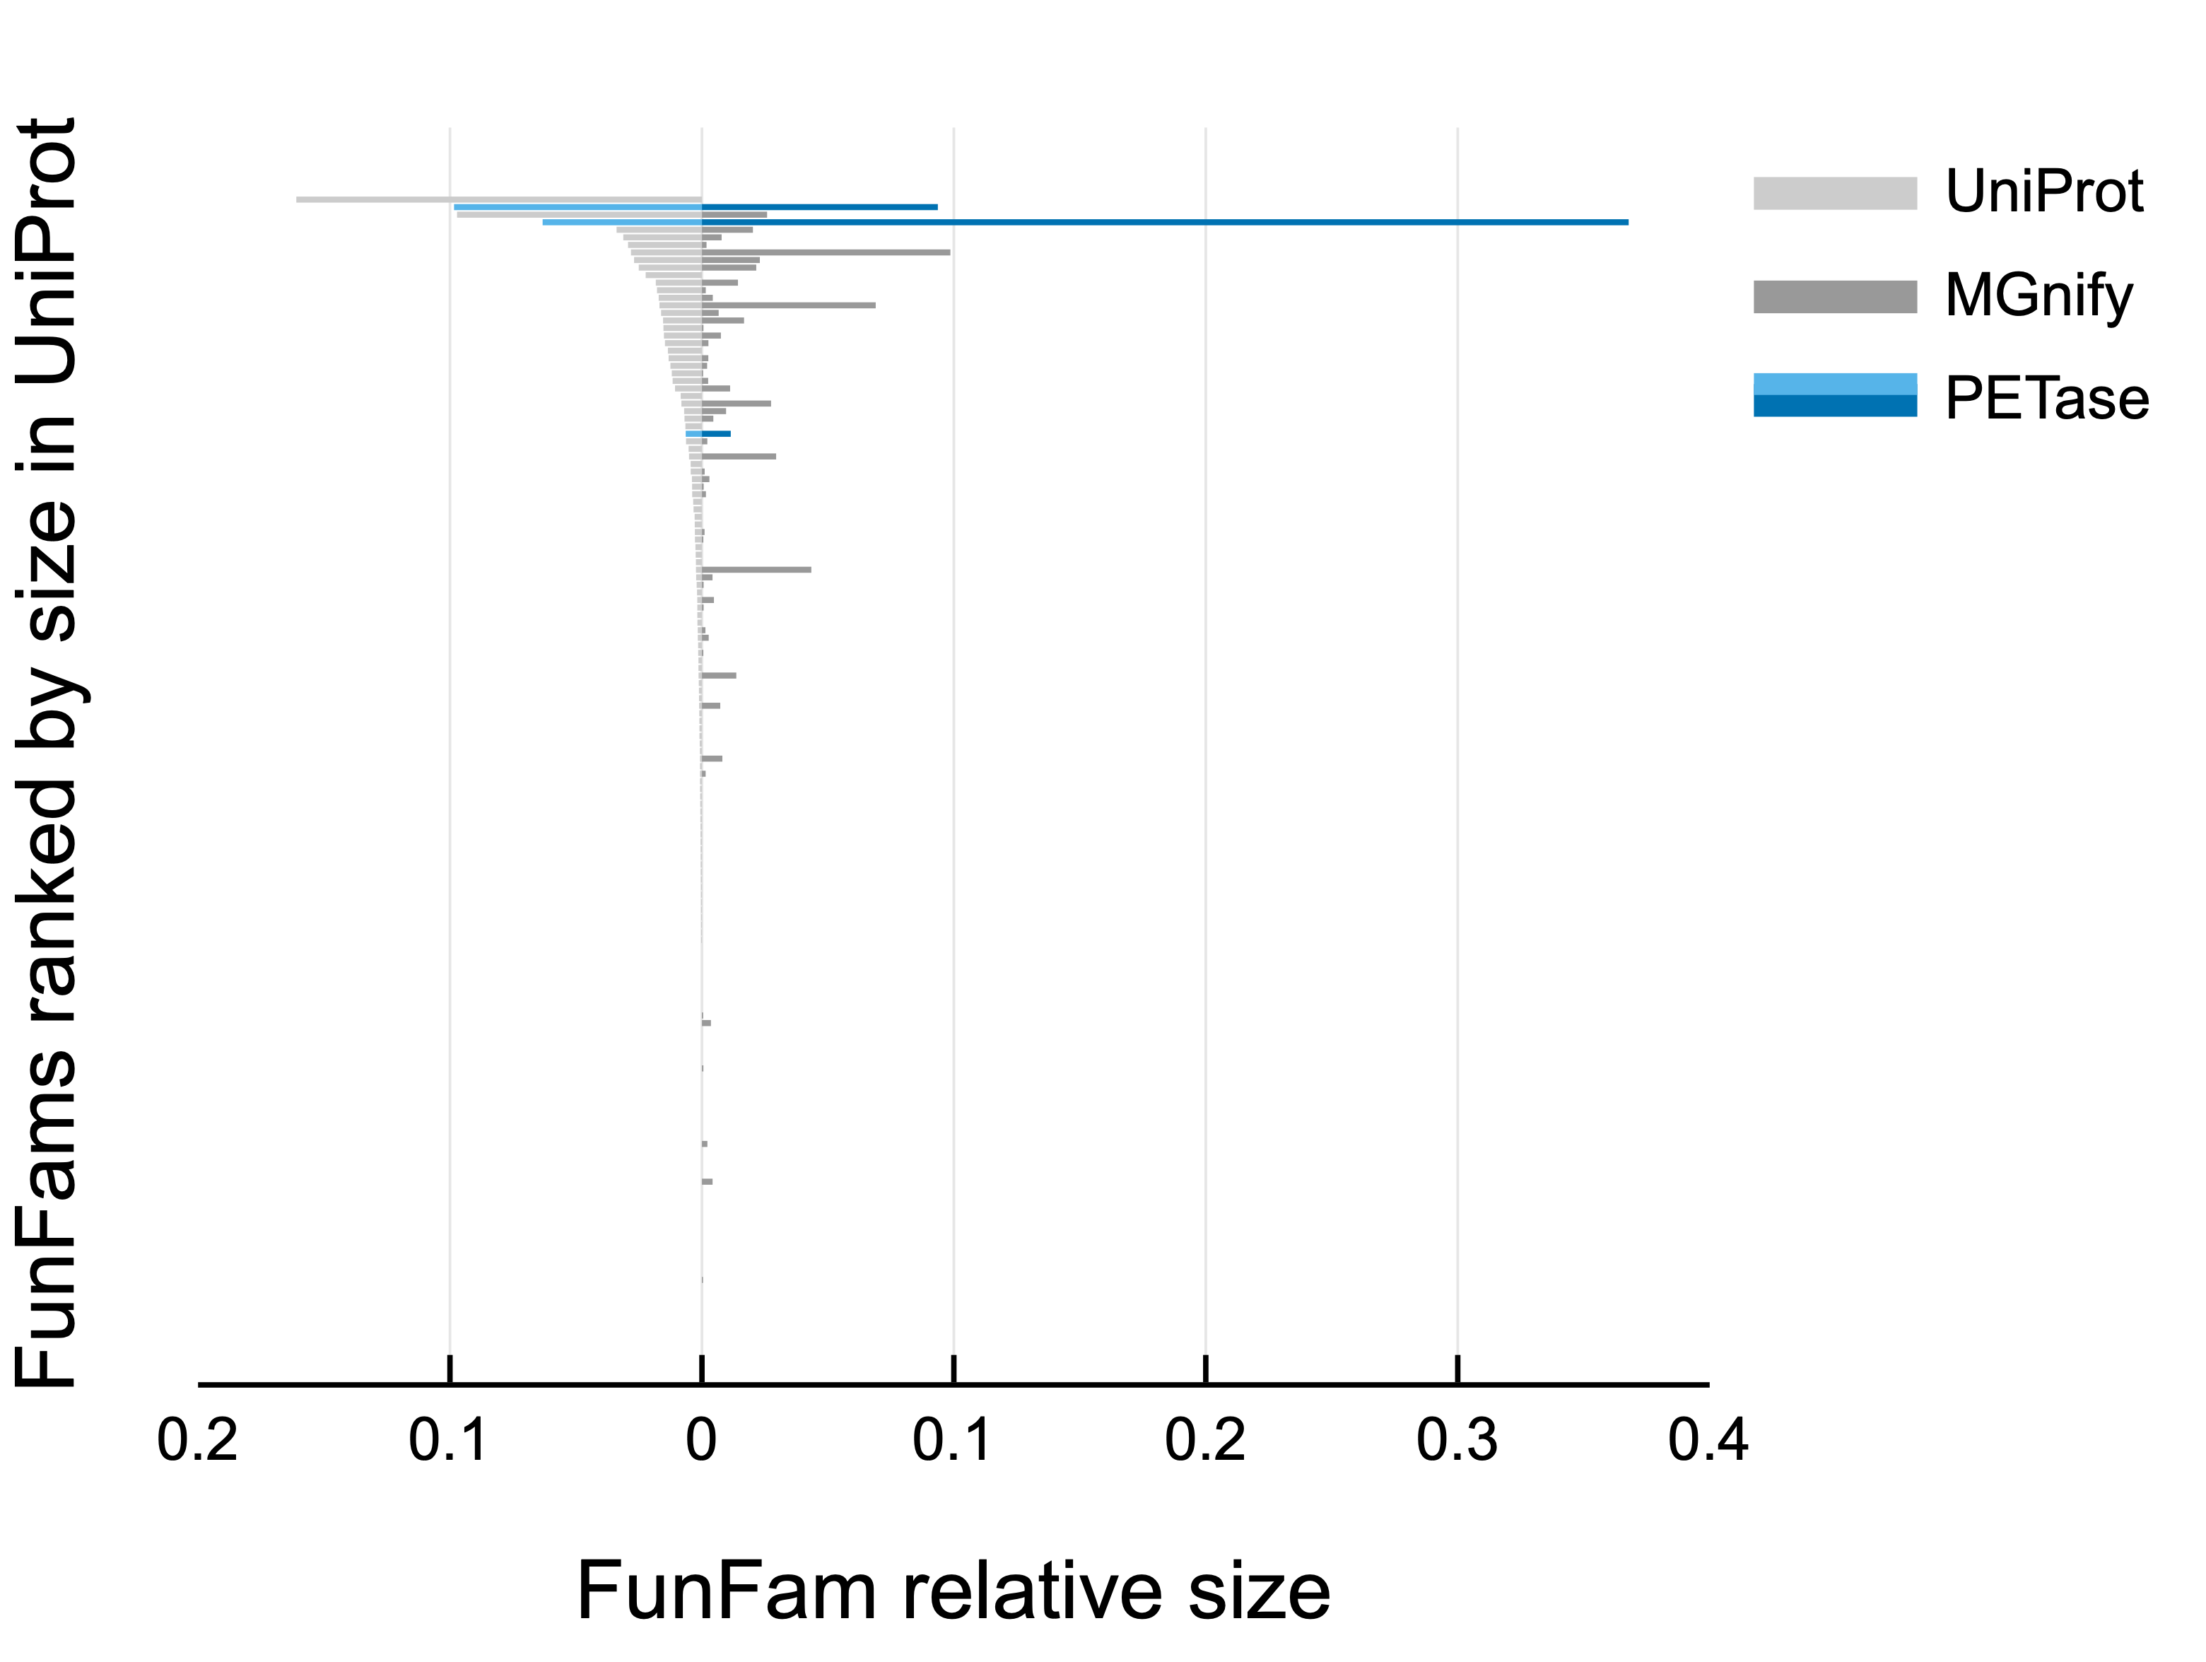
~2000 FunFams
Relative size by number of sequences
Notes:
2000 FunFams ranked by size. Hydrolise a great variety of substrates.

Slide 31
~2000 FunFams
Relative size by number of sequences
Notes:
2000 FunFams ranked by size. Hydrolise a great variety of substrates.
PETase have the biggest FunFam expansion in MGnify for alfa/beta hydrolyses

Slide 32
A much faster method is needed
Already a big family in 4.3 (110,922 sequences)
Number of starting clusters too high (4k)
Preliminary analyses -> Metagenomes is 1.5 m starting clusters
Increase speed without losing accuracy
Notes:
Find new FunFams, no experimental characterisation, need to cluster everything.

Slide 33
Random partitioning
DOMAIN B
B
MDA-1
B
A
B
C
MDA-2
A
B
C
A
B
MDA-3
30,000 starting clusters
B
A
15 partitions of
2000 starting clusters
HPC memory constraints
MDA-4
B
A
A
B
B1
MDA-5
B
B
MDA-6
Notes:
Random partitioning to lower the number of sc
Split in 15 with 2000 sc each, create a tree for each
A more sophisticated approach was tested
More time consuming, no differences in accuracy

Slide 34
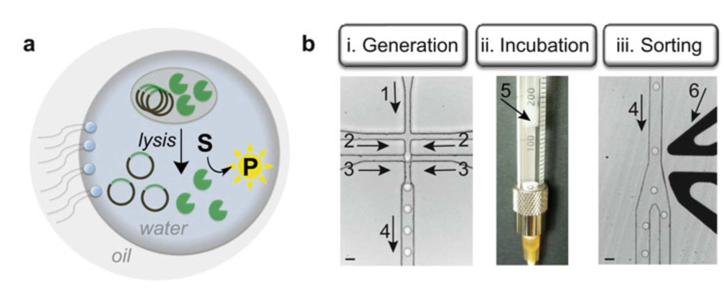
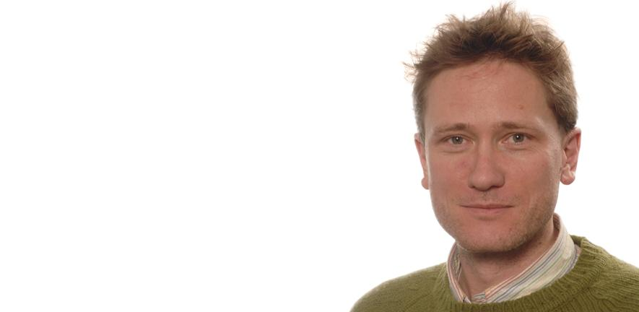

Exploring the PETases sequence neighbourhood
FF-937
FF-1299
PETases
FF-256
Ultrahigh-Throughput Screening
of Single-Cell Lysates.
Gielen et al. 2017
FF-151
FF-741
Prof. Florian Hollfelder University of Cambridge
link length —> change in active sites residues
Notes:
Circles are clusters of sequences with similar function

Slide 35
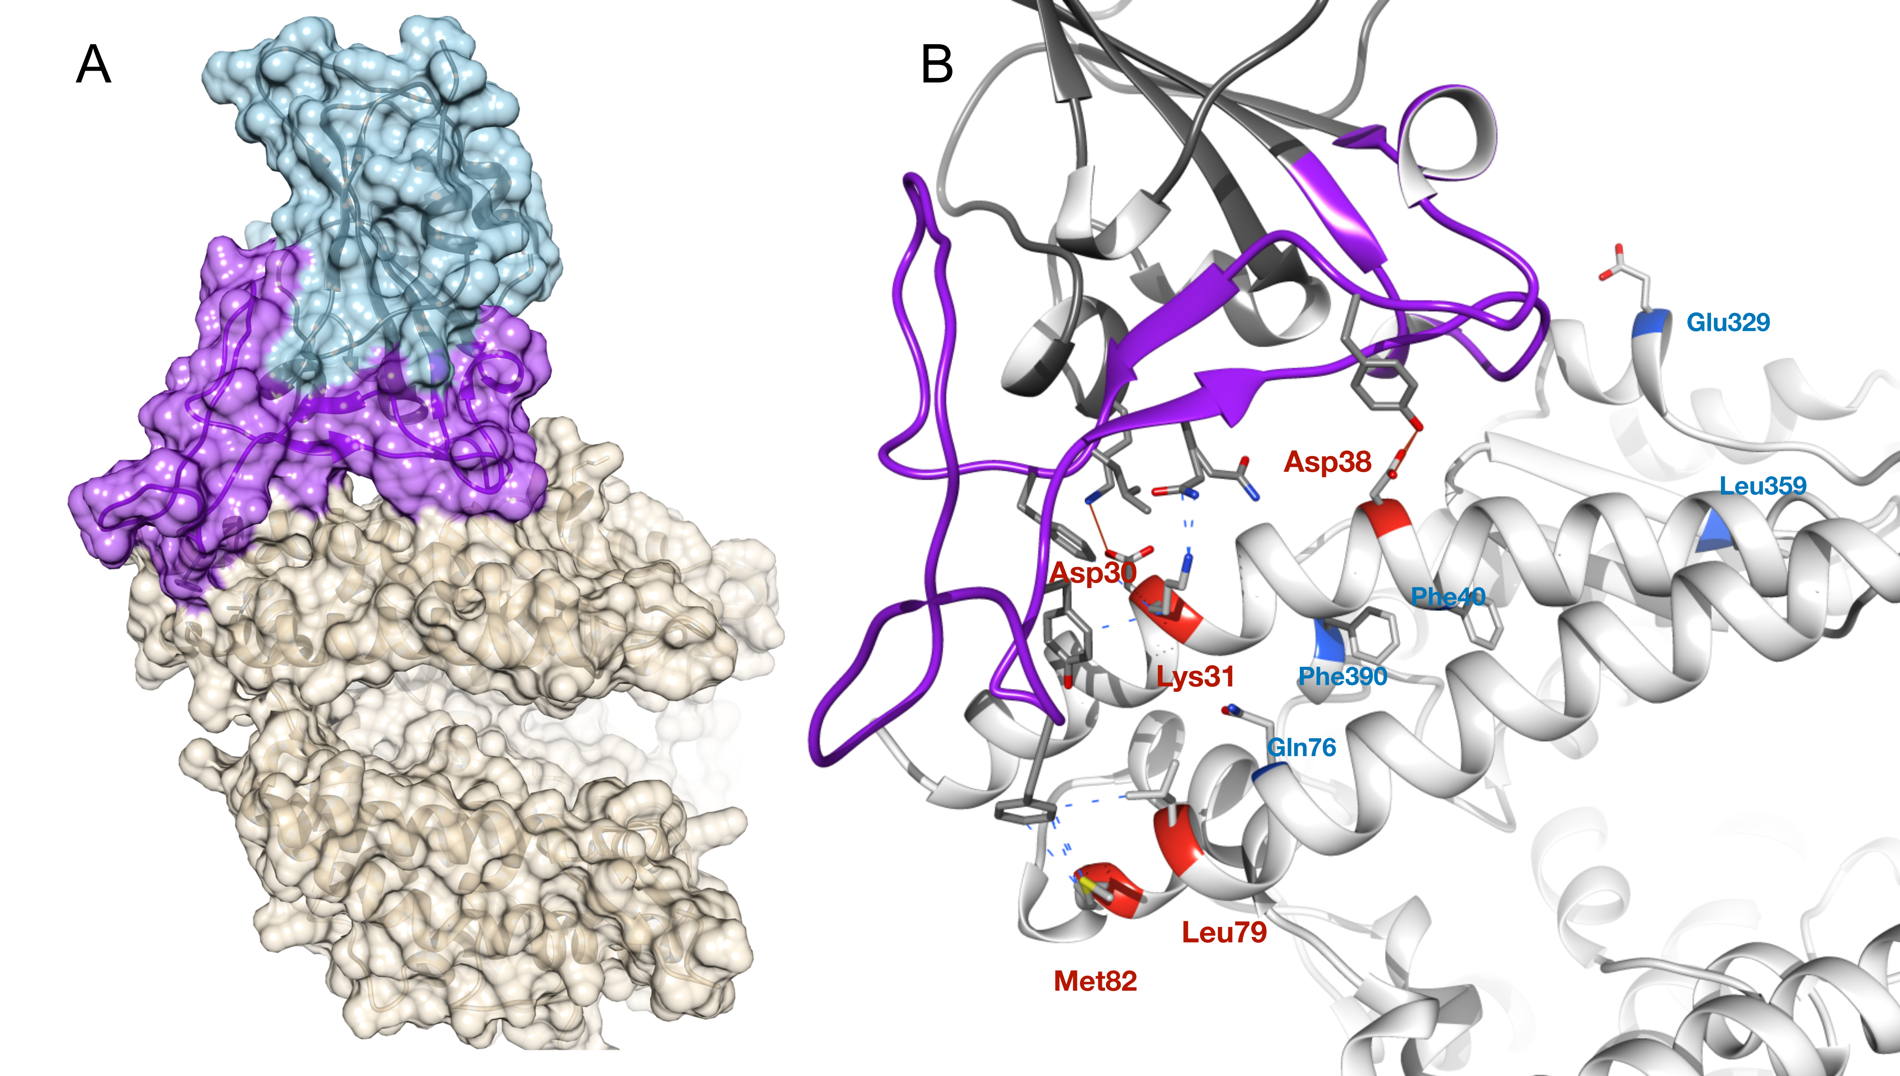
SARS-CoV-2
Spike
Binding of CoV-2:Spike protein
to human ACE2
is the first step in infection
ACE2
Notes:
Know residues in the interface, some residues were identified with FunFams

Slide 36

SARS-CoV-2
Notes:
Spike protein binding to ACE2 key element in viral infection process. Su Datt -> Model the interaction between Spike Protein and ACE2.
Jon suggested to check animals in domestic environments, like dogs and cats. (mentioned in the news)
Jo Santini suggested we model and investigate all animals as potential reservoirs of the virus.

Slide 37
SARS-CoV-2
Spike
ACE2
Notes:
Know residues in the interface, some residues were identified with FunFams

Slide 38
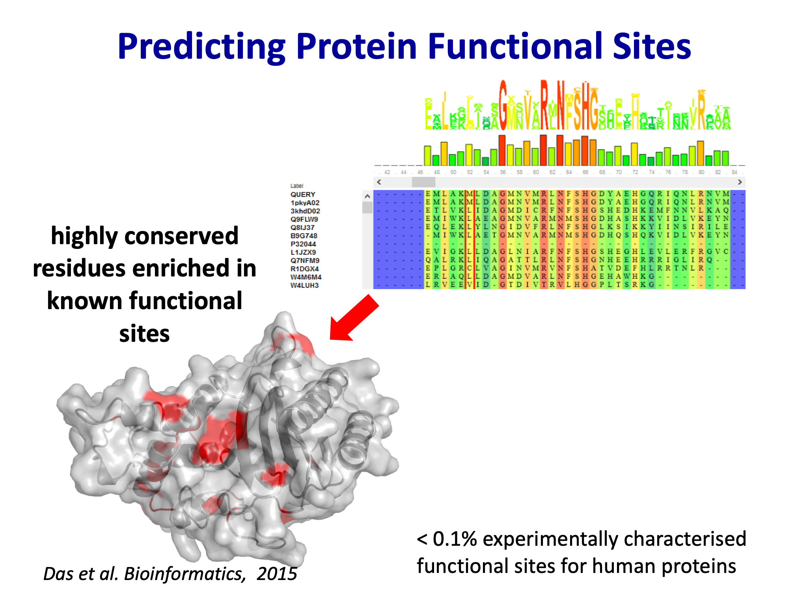
Clustered in allosteric region
Notes:
FunFams allow us to determine functional sites that are highly conserved. Identified additional key residues that are clustered in allosteric region

Slide 39
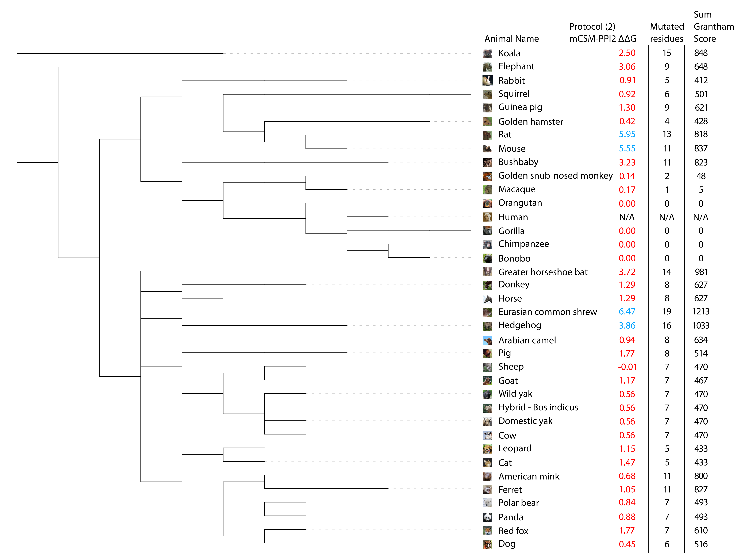
Notes:
mCSM-PPI2
Originally by T.Blundell
Changes in energy of the complex
The threshold was set on horse-shoe bat
31 experimental agrees with predictions
2 monkeys predicted risk, but experiments are a no

Slide 40
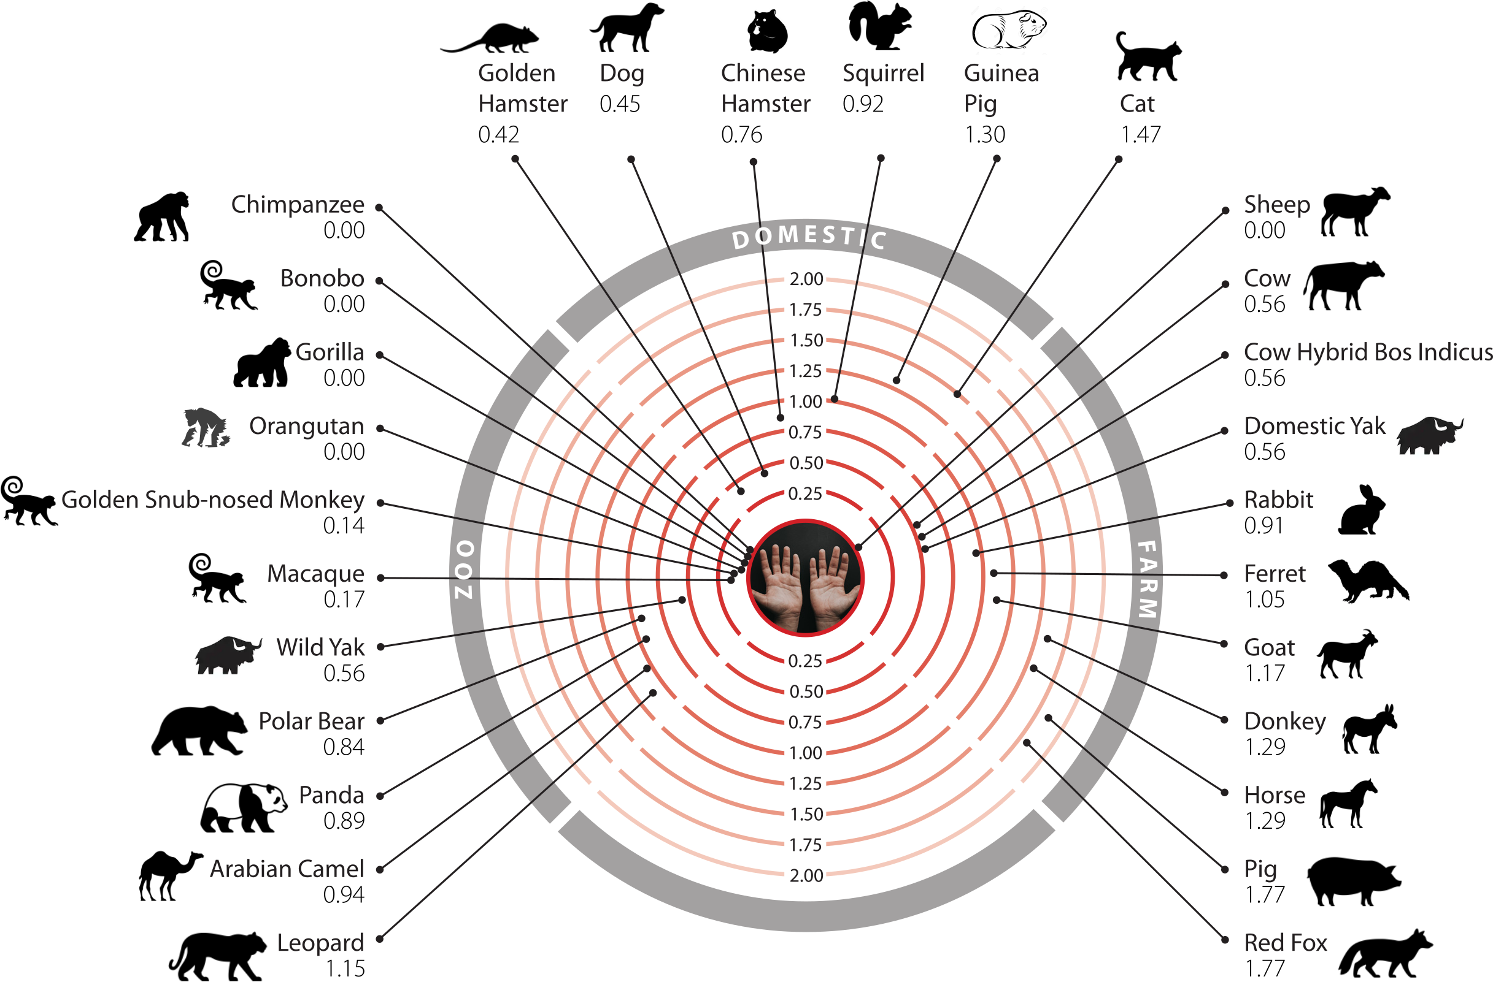
Notes:
These are animal models, the more positive, the less stable the complex is.
This is a model, to be used for guiding in-vivo experiments and closely monitor for reservoirs.

Slide 41
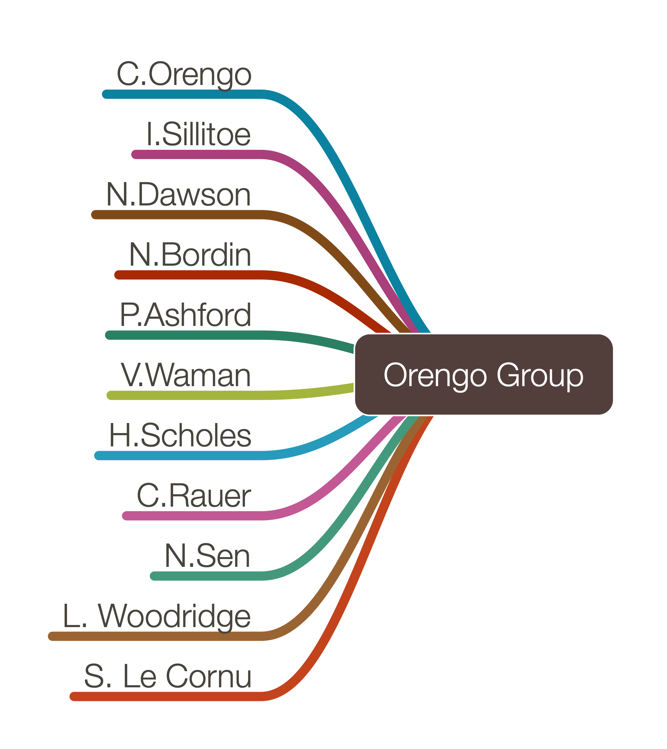



Acknowledgements
C
A
T
H

